Slide 1
MGS 425 (S1S) Management of it projects
Week 6 – March 8th

Slide 2
Agenda
Reminder: Mid-Term exam covers material up to and including this week.
Available on UBlearns starting on Tuesday, 3/16 at 6 pm and available until the following day, Wednesday, 3/17 at 12 noon.
Zoom check in calls will be held at several points during this timeframe.
Three short-answer questions.
Chapter 11 – Development Team.
Chapter 12 – Scrum Team Structures.
Chapter 13 – Managers.
TopHat assignment will be given based on material from this week.

Slide 3
Development Team
Chapter 11

Slide 4
Development Team – Overview
Chapter Agenda
Overview.
Role-Specific Teams.
Principal Responsibilities.
Characteristics/Skills
Closing

Slide 5
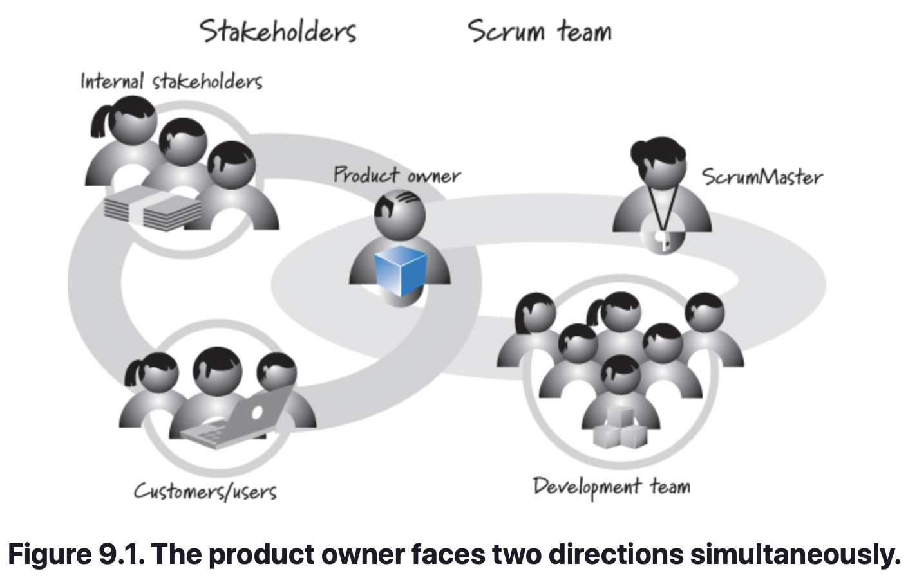
Development Team – Overview
Chapter Summary
Traditional software development approaches define various job types, such as architect, programmer, tester, database administrator, UI designer, and so on.
Scrum defines the role of development team, which is simply a cross-functional collection of these types of people.
The term development team may appear to be the wrong label to apply to a team that is composed of more than just developers.
For now, the Scrum community has converged on the use of the term development team, and I will use that term in this book.

Slide 6
Development Team – Role-Specific Teams
Many organizations are accustomed to intentionally splitting different job roles into specialized, role-specific teams.
These organizations might have one team of designers, one of developers, and another of testers. These teams hand off work to one another when it is complete and more or less function independently of each other.
In Scrum, the development team must do all of the work to produce one or more vertical slices of working product functionality each sprint, including the design, development, integration, and testing of that functionality. Thus, we need a team that is skilled at all of those tasks.
Whenever possible, create cross-functional teams. Parceling the work out to different role-specific teams is suspect and is likely a serious impediment to the successful use of Scrum. Make sure you have a real need (besides habit) for keeping any role-specific teams.

Slide 7
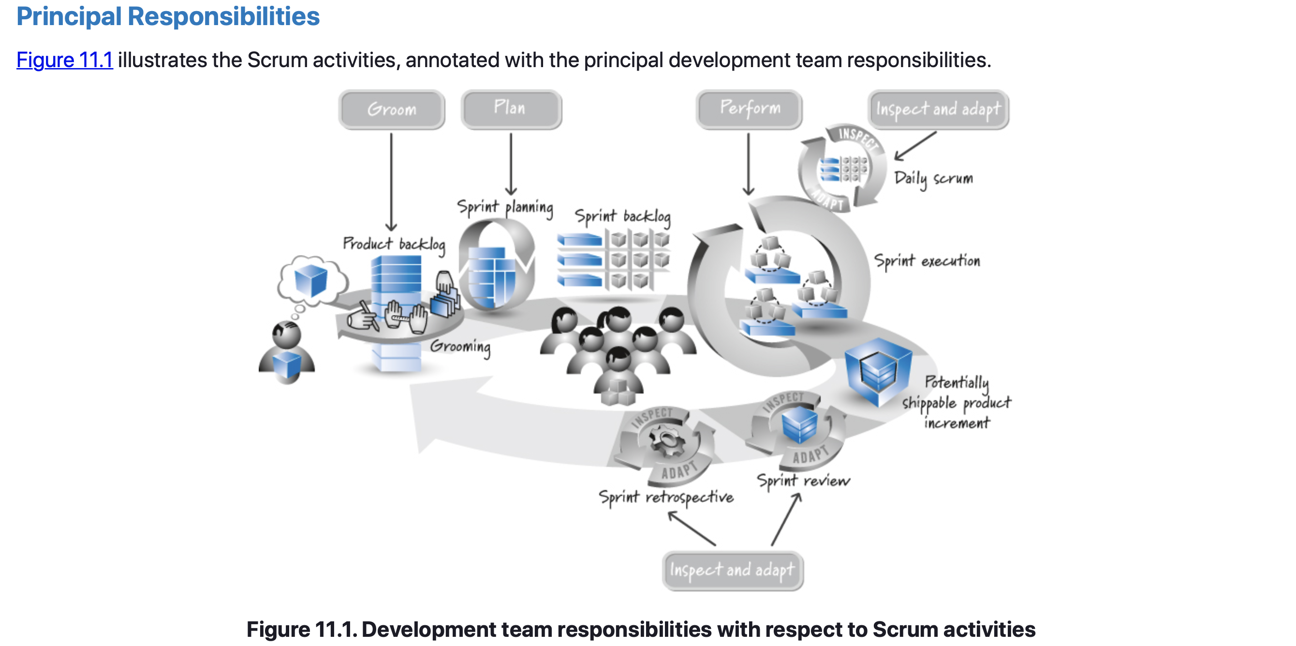
Development Team – Principal Responsibilities

Slide 8
Development Team – Principal Responsibilities
Perform Sprint Execution
The hands-on, creative work of designing, building, integrating, and testing product backlog items into increments of potentially shippable functionality.
The development team spends a majority of its time performing sprint execution.
Inspect and Adapt Each Day
Each development team member is expected to participate in each daily scrum, during which the team members collectively inspect progress toward the sprint goal and adapt the plan for the current day’s work.
If some team members do not participate, the team can miss pieces of the big picture and may fail to achieve its sprint goal.

Slide 9
Development Team – Principal Responsibilities
Groom the Product Backlog
Part of each sprint must be spent preparing for the next – Grooming.
The development team should allocate up to 10% of its available capacity every sprint to assist the product owner with these activities.
Plan the Sprint
At the beginning of each sprint, the development team participates in sprint planning.
In collaboration with the product owner and with facilitation from the ScrumMaster, the development team helps to establish the goal for the next sprint.
The team then determines which high-priority subset of product backlog items to build to achieve that goal.
Inspect and Adapt the Product and Process
At the end of each sprint, the development team participates in the two inspect-and-adapt activities: sprint review and sprint retrospective.

Slide 10
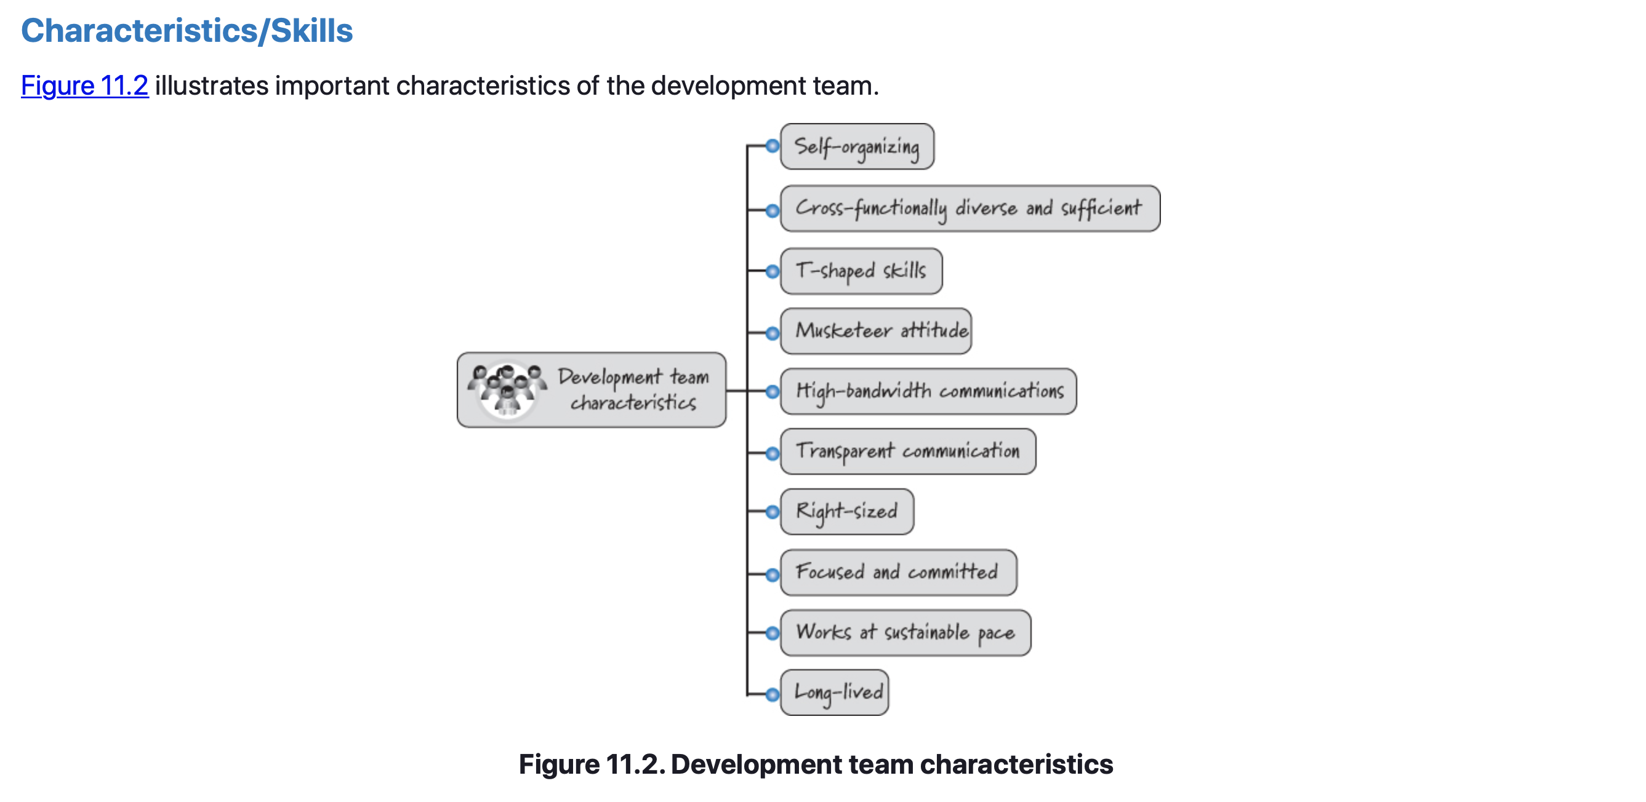
Development Team – Characteristics/Skills

Slide 11
Development Team – Characteristics/Skills
Self-Organizing
Team members self-organize to determine the best way to accomplish the sprint goal.
There is no project manager or other manager who tells the team how to do its work (and a ScrumMaster should never presume to).
Self-organization is a bottom-up, emergent property of the system—there is no external dominating force applying traditional top-down, command-and-control management.
The development team has no top-down command-and-control authority that tells the team how to do its work.
Instead, a cross-functionally diverse team of people organize themselves in the most appropriate way to get work done.

Slide 12
Development Team – Characteristics/Skills
Cross-Functionally Diverse and Sufficient
Development team members should be cross-functionally diverse; collectively they should possess the necessary and sufficient set of skills to get the job done.
A well-formed team can take an item off of the product backlog and produce a good-quality, working feature that meets the Scrum team’s definition of done.
Teams composed solely of people with the same skills (traditional silo teams) can at most do part of the job.
As a result, silo teams end up handing off work products to other silo teams.
Handoffs represent an excellent opportunity for miscommunication and costly mistakes.
Having diverse teams minimizes the number of handoffs. And creating diverse teams doesn’t prevent us from having multiple team members who might be highly skilled in the same discipline such as Java or C++ development or testing.

Slide 13
Development Team – Characteristics/Skills
Cross-Functionally Diverse and Sufficient
A cross-functionally diverse team has members from different backgrounds. Each team member brings a set of cognitive tools for problem solving; these tools can involve different interpretations (of the same data), different strategies (or heuristics) for solving problems, different mental models of how things work, and different preferences for both approaches and solutions.
This kind of diversity typically leads to better outcomes in terms of faster solutions, higher-quality deliverables, and greater innovation, all of which translate into greater economic value (Page 2007).
We should also strive for team diversity by having a good mix of senior- and junior-level personnel on the same team. Too many senior-level people might cause unnecessary turbulence, similar to having too many cooks in the kitchen. Too many junior people, however, and the team might not be sufficiently skilled to get the job done. A good mix promotes a healthy, collaborative learning environment.

Slide 14
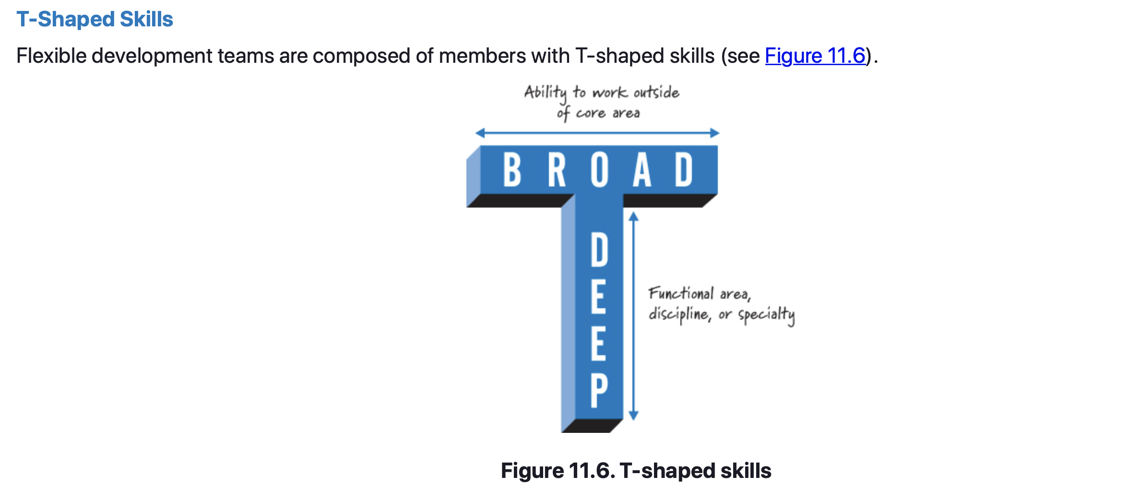
Development Team – Characteristics/Skills

Slide 15
Development Team – Characteristics/Skills
T-Shaped Skills
T-shaped skills mean that a team member (say, Sue) has deep skills in her preferred functional area, discipline, or specialty.
For example, Sue is a great user-experience (UX) designer—that is her specialty and where she prefers to do work. Sue, however, can also work outside of her core specialty area, doing some testing and some documentation.
She isn’t as good a tester or documenter as those who specialize in those areas, but she can help out with testing or documentation if that’s where the team is experiencing a bottleneck and needs to swarm people to get the job done.
In this respect Sue has broad skills that allow her to work outside her core area.
Notes:
It’s unrealistic to believe that every person on a team could work on every task. That’s a lofty goal to have. For example, in domains with intense specialization, like video game development, where a team could have an artist, animator, audio engineer, artificial intelligence (AI) programmer, and tester, it’s unreasonable to assume that everyone can do every job. If I were on a team developing a video game, I could work on the AI and do some testing, but I couldn’t work on the art design (and you wouldn’t want me to!). However, I might be able to help the artists with nonartistic design work such as using Photoshop to convert file formats or create scripts to apply operations on multiple files.

Slide 16
Development Team – Characteristics/Skills
T-Shaped Skills
Managers should focus on forming teams that have the best set of T-shaped skills that are possible with available personnel.
It might not be possible to get exactly the desired team skill set from the get-go, so the desired skill set could evolve over time as the needs of the product development effort evolve.
Therefore, it is critical to have an environment where people are constantly learning and adding to their skill sets, whether those include domain knowledge, technical knowledge, thinking skills, or other capabilities. Management needs to support team members with time to learn and experiment.

Slide 17
Development Team – Characteristics/Skills
T-Shaped Skills
Is it OK to have pure specialists on the team? Let’s take our earlier example of Sue and assume she is a great UX designer, but that’s all she can do.
Because we have so few UX designers, we really don’t want her doing anything but critical UX design work. We need her skills on the team, but we’ll be able to fill only about 10% of her time with team-related work. In these cases, an obvious solution is to divide Sue’s time among multiple teams.
However, we must be practical. Sue would be far too fractured if she divided her time in 10% increments to many teams at the same time. She would soon become a bottleneck (see the “Focused and Committed” section later in this chapter).

Slide 18
Development Team – Characteristics/Skills
T-Shaped Skills
Recall from Chapter 3 that our goal shouldn’t be to keep people like Sue 100% utilized. Instead, we should be more concerned about the idle work (the baton sitting on the ground) that occurs when we rely too much on an overutilized resource.
Therefore, we might allocate Sue as a specialist to a reasonable number of products, but not so many that she is the cause of baton dropping.
Because our goal is to achieve good flow with team members who have broad T-shaped skills, we should encourage Sue to help other team members acquire reasonable UX design knowledge so that we no longer need to rely so heavily on specialists.
Most team members should have T-shaped skills, but we still might have some specialists in the mix.

Slide 19
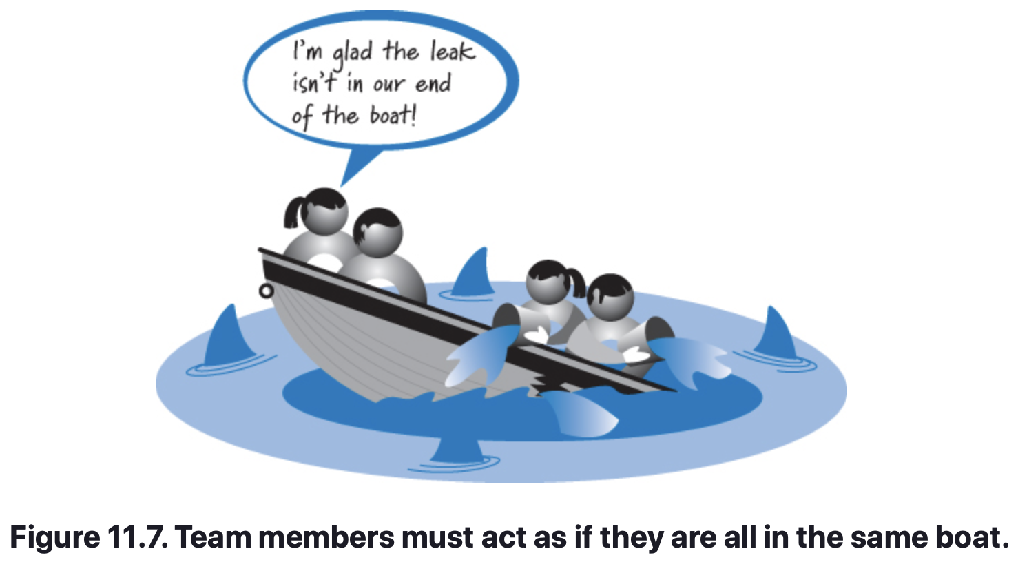
Development Team – Characteristics/Skills
Musketeer Attitude
Members of the development team (and the Scrum team as a whole!) need to have the same attitude as the Three Musketeers—“All for one and one for all.”
This Musketeer attitude reinforces the point that the team members collectively own the responsibility of getting the job done. They win as a team or they fail as a team.
In a well-functioning Scrum team, I would never expect anyone to say, “I got my part done. You didn’t get your part done. Therefore we failed.” This attitude misses the point that team members are all in the same boat together (see Figure 11.7).
Team members must appreciate that they must work together to meet their commitments, because if they fail, it’s going to be everybody’s problem in the end.

Slide 20
Development Team – Characteristics/Skills
High-Bandwidth Communications
Development team members need to communicate with one another, as well as with the product owner and ScrumMaster, in a high-bandwidth manner, where valuable information is exchanged quickly and efficiently with minimal overhead.
High-bandwidth communications increase both the frequency and quality of information sharing.
Face-to-face communication is a preferred approach. Certainly, team members who are physically separated or primarily use noninteractive communication (such as documents) are at a disadvantage to collocated team members engaged in real-time, face-to-face collaboration.
Teleconferencing equipment can make it feel like everyone is collocated, when required due to geographical constraints, but is not the most preferred method.
Having small-sized teams also improves bandwidth.

Slide 21
Development Team – Characteristics/Skills
Transparent Communications
In addition to being high bandwidth (fast and efficient with minimal overhead), communication within the team should be transparent.
Transparent communication provides a clear understanding of what is actually happening to avoid surprises and help build trust among the team members.
Teams should communicate in a way that aligns with the spirit of the principle of least astonishment. Simply put, people should communicate in a way that is least likely to surprise one another.
Be direct, truthful, and don’t “sugar-coat” a message in order to mask an underlying message.

Slide 22
Development Team – Characteristics/Skills
Right-Sized
Scrum favors small teams. The general rule is that having five to nine people on the team is best.
Mike Cohn lists a handful of reasons to keep teams small, which include the following (Cohn 2009):
There is less social loafing—people exerting less effort because they believe that others will pick up the slack.
Constructive interaction is more likely to occur on a small team.
Less time is spent coordinating efforts.
No one can fade into the background.
Small teams are more satisfying to their members.
Harmful overspecialization is less likely to occur.

Slide 23
Development Team – Characteristics/Skills
Focused and Committed
Team members need to be focused and committed to the team’s goal.
Focused means that each team member is engaged, concentrating on and devoting her attention to the team’s goal.
Committed means that during both good times and bad, each team member is dedicated to meeting the team’s collective goal.
If a person is working on only one product, it is far easier for that person to be focused and committed.
When asked to work on multiple concurrent product development efforts, a person must split her time across those products, reducing her focus and commitment on all products.

Slide 24
Development Team – Characteristics/Skills
Work at a Sustainable Pace
One of Scrum’s guiding principles is that team members must work at a sustainable pace.
In doing so, they deliver world-class products and maintain a healthy and fun environment.
Using sequential development, we defer important activities like integration and testing until near the end, when there typically is a crushing workload of issues to deal with as we approach the delivery date.
The overall intensity of work during each sprint should closely resemble the intensity of the previous sprint, reinforcing the team’s working at a sustainable pace.

Slide 25
Development Team – Characteristics/Skills
Long-Lived
Effective use of Scrum requires teams, not groups.
A team is made up of a diverse, cross-functional collection of collaborating people who are aligned to a common vision and work together to achieve that vision.
A group is a collection of people with a common label. Other than sharing the group name, group members don’t share much else and won’t effectively fulfill the responsibilities described for the development team role.
As a rule, teams should be long-lived.
Research by Staats demonstrates that team familiarity (team members’ prior shared work experience) can positively impact the efficiency and quality of team output (Staats 2011). Improved productivity, efficiency, and quality lead to improved business results.

Slide 26
Development Team – Characteristics/Skills
Closing
Described the team role.
Emphasized how the team is responsible for turning product backlog items into potentially shippable product increments.
Discussed the responsibilities of the team during each sprint.
Listed ten characteristics we want from our teams.
To remain focused and committed, we prefer that team members work on only one or two development efforts at a time.
Looking longer-term, we prefer to select team members who can stay together for an extended period of time on long-lived teams.

Slide 27
Scrum Team Structures
Chapter 12

Slide 28
Scrum Team Structures – Overview
Chapter Agenda
Overview.
Role-Specific Teams.
Principal Responsibilities.
Characteristics/Skills.
Closing.

Slide 29
Scrum Team Structures – Overview
Chapter Summary
Coordinate the work of multiple Scrum teams whose combined effort is required to deliver increasingly greater business value.
Structure of these teams so that they are high performing and well coordinated.
Creation of feature or component teams and what approaches can be used for coordinating multiteam activities.

Slide 30
Scrum Team Structures
Feature Teams versus Component Teams
A feature team is a cross-functional and cross-component team that can pull end-customer features from the product backlog and complete them.
A component team focuses on the development of a component or subsystem that can be used to create only part of an end-customer feature.
Component teams are sometimes referred to as asset or subsystem teams. Often a community of practice made up of people with a similar specialty skill also functions like a component team.
On these teams, all members likely report to the same functional manager and might operate as a shared, centralized resource to other teams. One example might be the centralized UX department that creates UI designs for other teams.
Notes:
In Chapter 6 I discussed how a GPS manufacturer might create a routing component team to manage the sophisticated code associated with determining a route from an origin to a destination. Any time there is a request for new GPS features that involves routing, the routing-specific pieces of those features would be assigned to the routing component team for development.

Slide 31
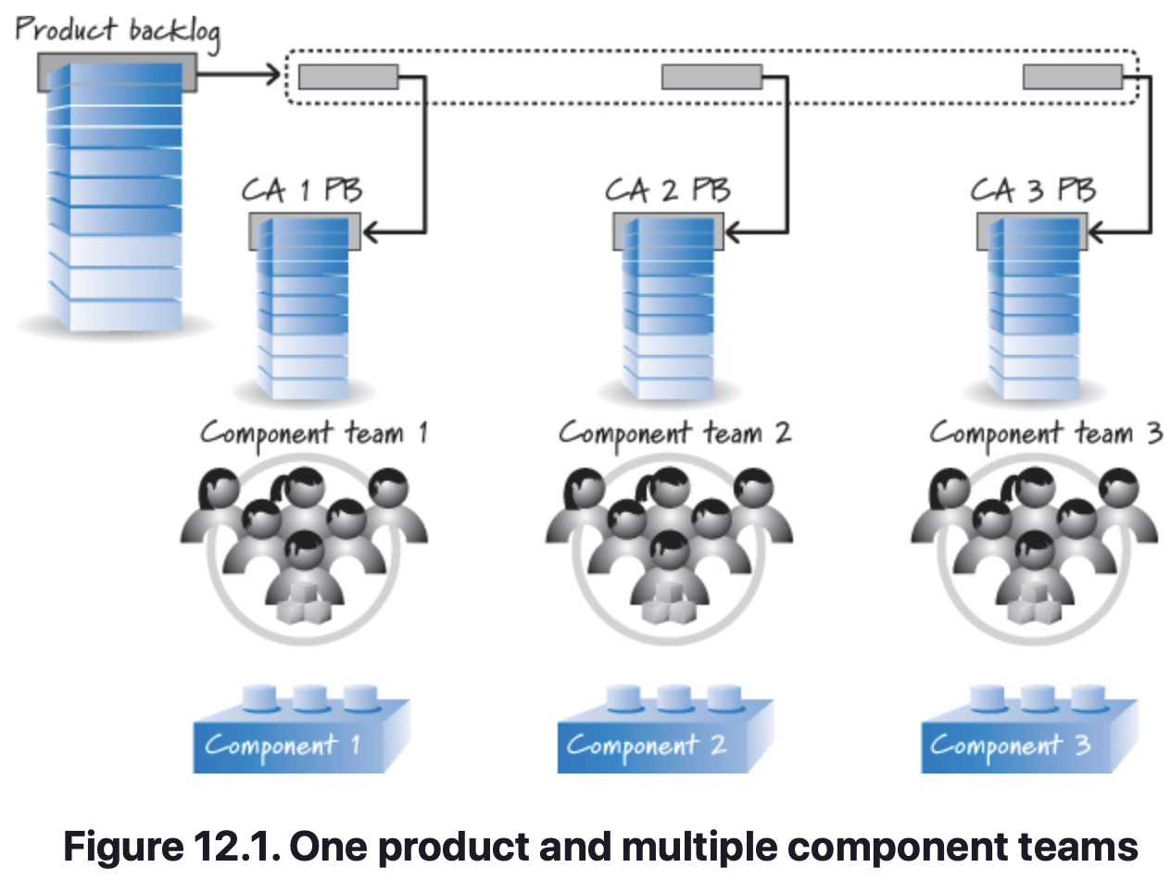
Scrum Team Structures
Feature Teams versus Component Teams
Let’s say we are developing a product whose features frequently cut across three component areas (see Figure 12.1).
In this example, there is no feature team that works on a complete product backlog item.
Instead, a feature is selected from the top of the product backlog and is split into its component-level pieces (the three pieces shown inside the dashed rectangle of Figure 12.1).
This splitting is done either collectively by the members of the component Scrum teams, or perhaps by an architect.

Slide 32
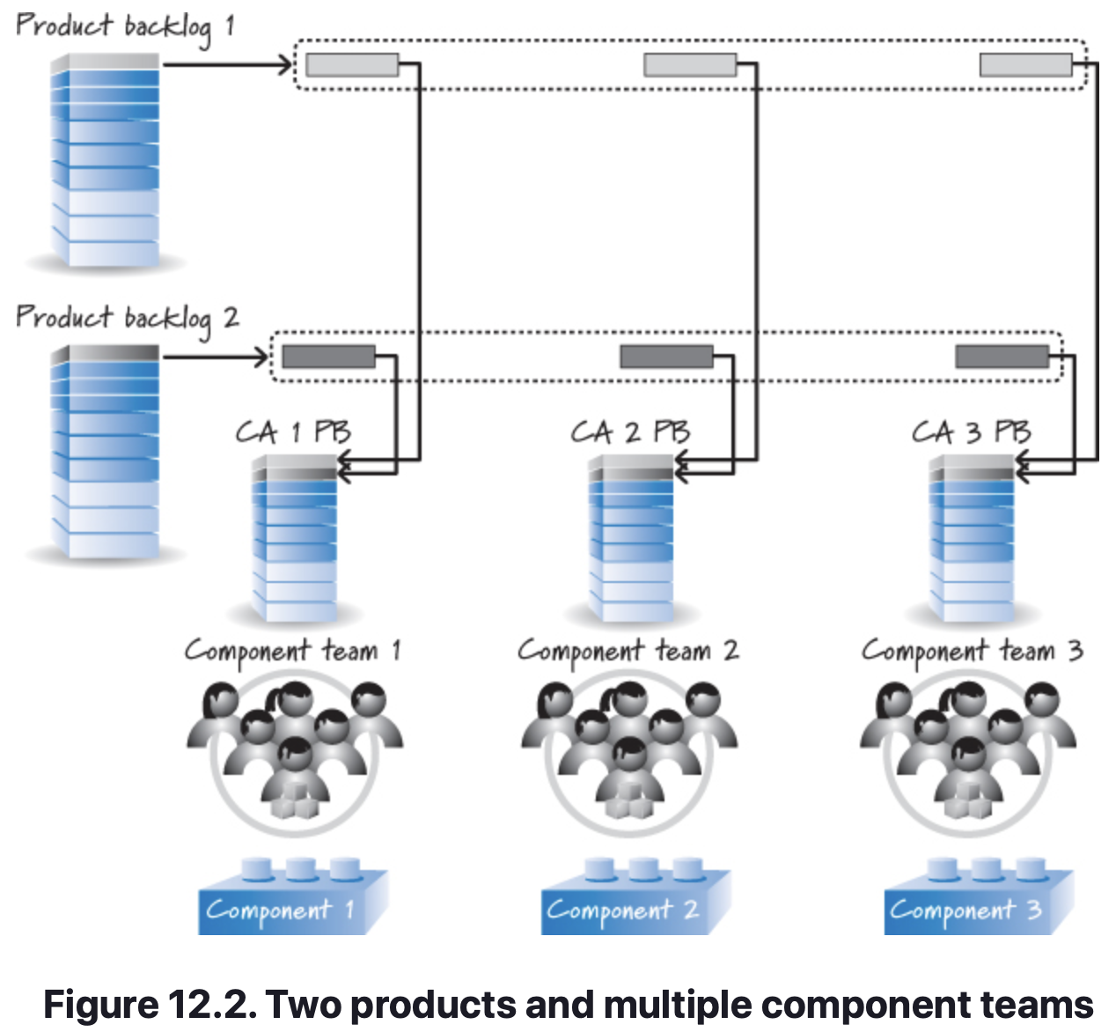
Scrum Team Structures
Feature Teams versus Component Teams
Many organizations frequently form component teams around component areas that they intend to reuse on multiple products.
Figure 12.2 shows how the work might flow if there were two products channeling requests to the same component teams.
Each feature-level product backlog contains end-customer-valuable items that can span the multiple component areas.
So, in Figure 12.2, there are now two products that need component teams to work on their specific component-level pieces.

Slide 33
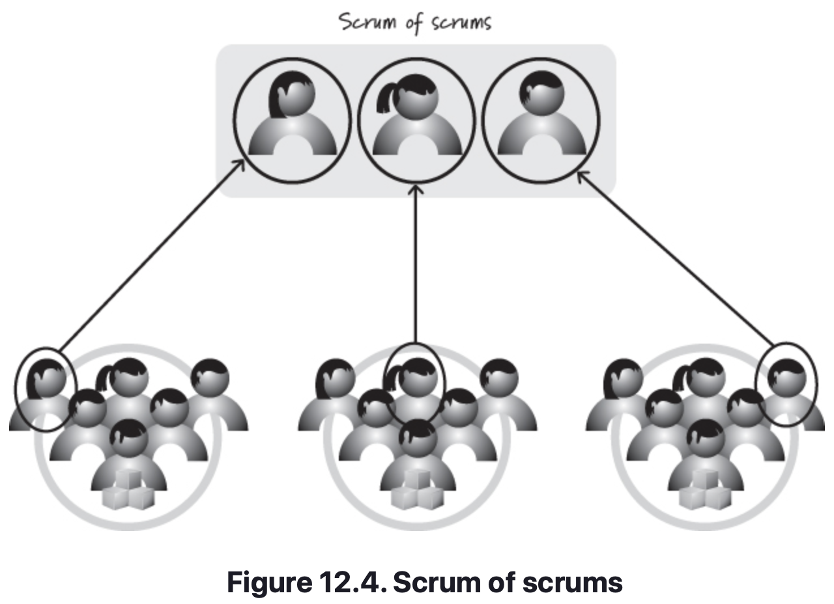
Scrum Team Structures – Multiple-Team Coordination
Scrum of Scrums
A common approach to coordinating work among multiple teams is the scrum of scrums or SoS (see Figure 12.4).
This practice allows multiple teams to coordinate their inter-team work.
The team that performs the SoS is composed of individual members of the various development teams.
Each development team determines which member to send to the scrum of scrums based on who can best speak to the inter-team dependency issues.

Slide 34
Scrum Team Structures – Multiple-Team Coordination
Scrum of Scrums
Some teams send both a development team member and their ScrumMaster to the SoS.
It might even make sense to have a ScrumMaster at the level of the scrum of scrums. If such a role exists, it could be filled by one of the individual team ScrumMasters or by a ScrumMaster not working directly with any of those teams.
The SoS is usually not held every day but instead a few times a week as needed. Participants at the scrum of scrums answer similar questions to the ones answered at the daily scrum:
What has my team done since we last met that could affect other teams?
What will my team do before we meet again that could affect other teams?
What problems is my team having that it could use help from other teams to resolve?

Slide 35
Scrum Team Structures – Multiple-Team Coordination
Release Train
A release train is an approach to aligning the vision, planning, and interdependencies of many teams by providing cross-team synchronization based on a common cadence.
A release train focuses on fast, flexible flow at the level of a larger product.
The train metaphor is used to imply that there is a published schedule of when features will “leave the station.”
All of the teams participating in the development of the product need to get their cargo onto the train at the appointed time.
The release train always departs on time and waits for no one.
Likewise, if a team misses the train, it need not fret because there will be another train departing at a known time in the future.

Slide 36
Scrum Team Structures – Multiple-Team Coordination
Release Train
Leffingwell defines the rules of a release train as follows (Leffingwell 2011):
Frequent, periodic planning and release (or potentially shippable increment—PSI) dates for the solution are fixed (dates are fixed, quality is fixed, scope is variable).
Teams apply common iteration lengths.
Intermediate, global, objective milestones are established.
Continuous system integration is implemented at the top, or system, level, as well as at the feature and component levels.
Release increments (PSIs) are available at regular (typically 60- to 120-day) intervals for customer preview, internal review, and system-level QA.
System-level hardening iterations are (or may be) used to reduce technical debt and to provide time for specialty release-level validation and testing.
For teams to build on top of similar constructs, certain infrastructure components—interfaces, system development kits, common installs and licensing utilities, user-experience frameworks, data and web services, and the like—must typically track ahead.

Slide 37
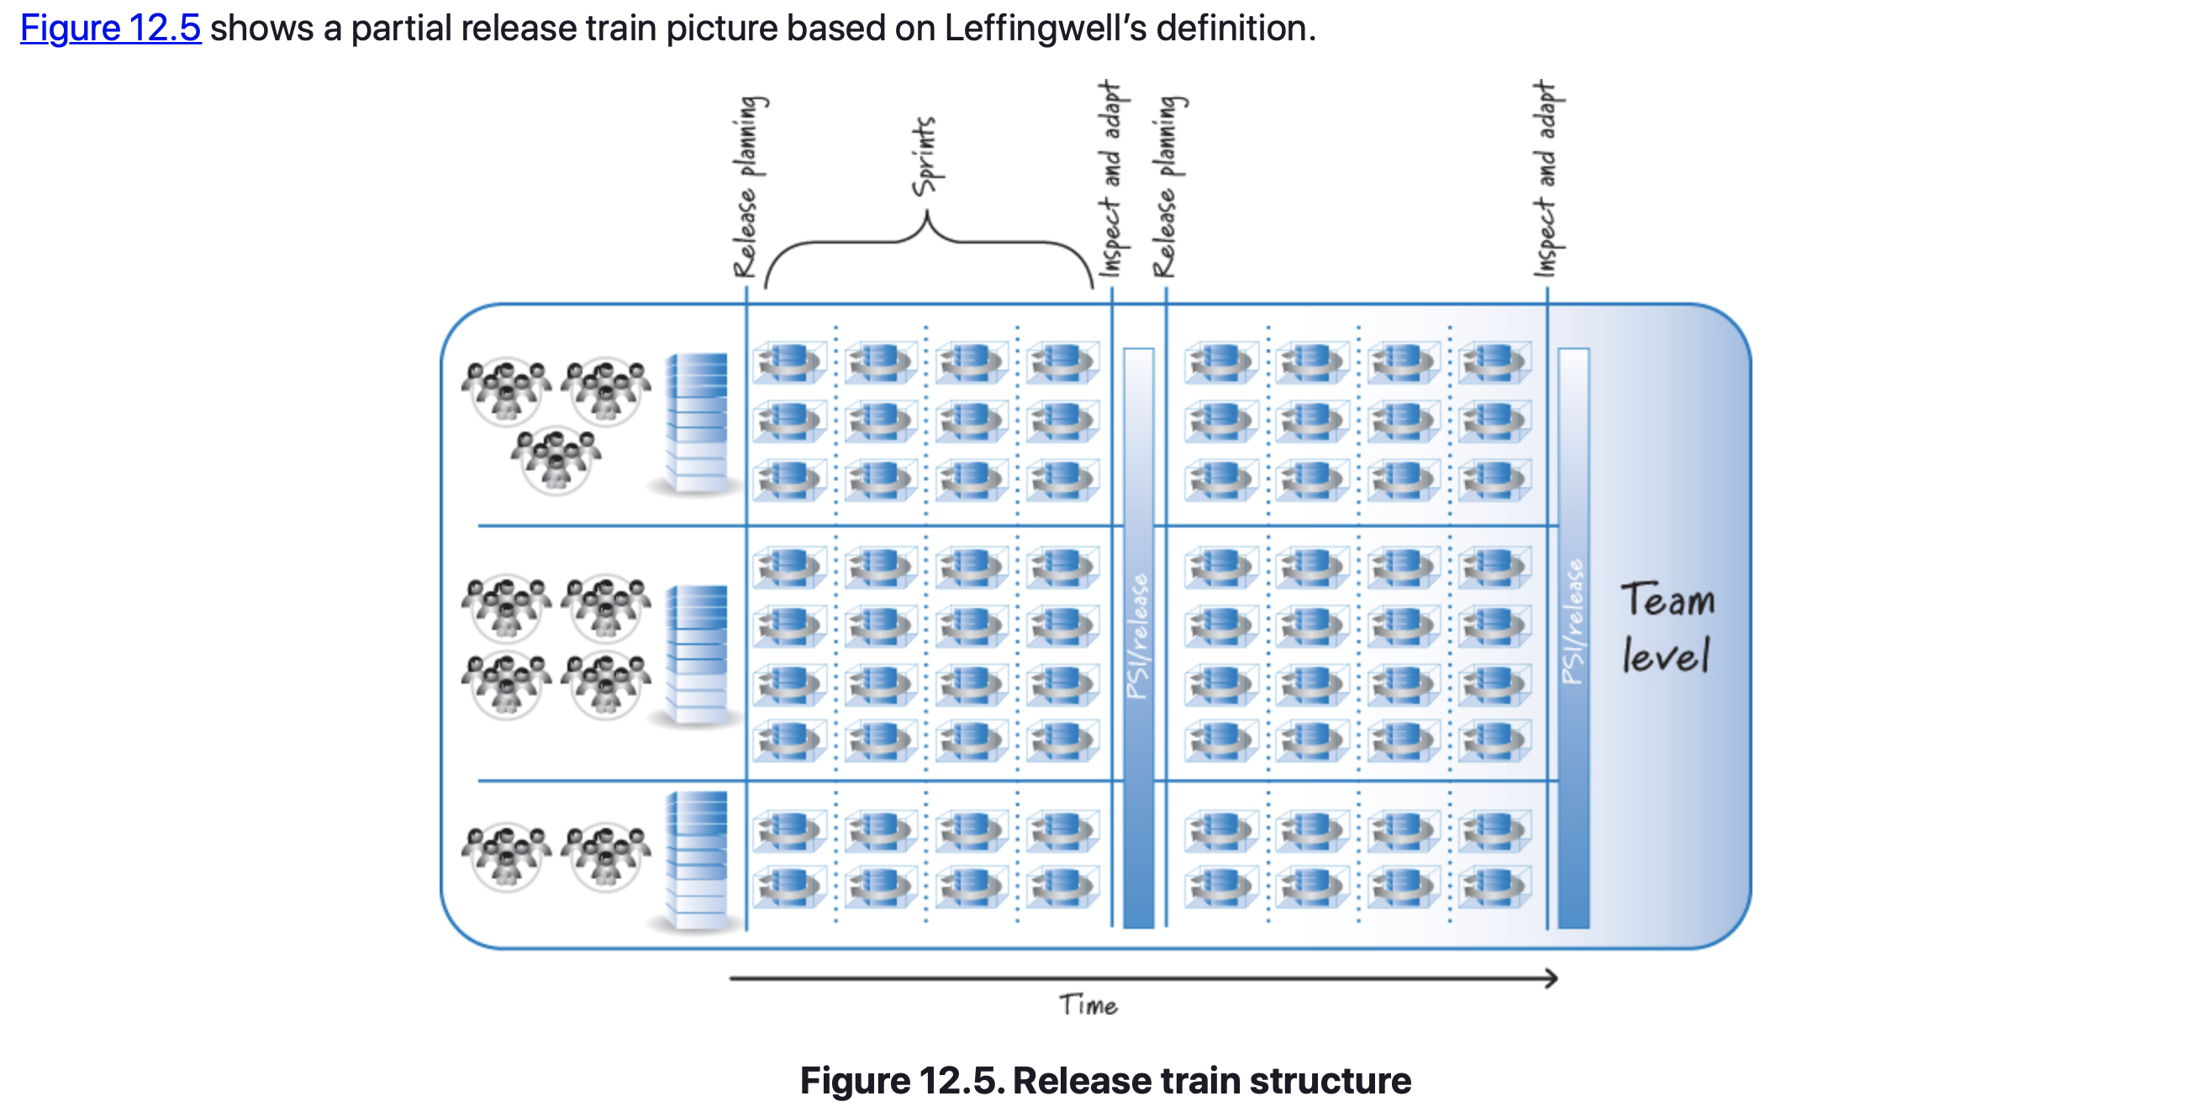
Scrum Team Structures – Multiple-Team Coordination
Release Train

Slide 38
Scrum Team Structures – Closing
Discussed different ways to structure Scrum teams.
Feature teams that are cross-functionally diverse and sufficient to pull an end-customer feature from a product backlog and get it done.
Compared feature teams with component teams that work in specific component, asset, or architectural areas, which represent only parts of what needs to be integrated into end-customer features.
Discussed the blended model of feature and component teams and how it could be used to help an organization transition to a point where it has mostly feature teams, each with excellent shared code ownership.
Discussed how to coordinate multiple Scrum teams, starting first with a traditional Scrum practice called the scrum of scrums and then describing a concept called a release train, which can be used to coordinate the activities of a large number of Scrum teams.

Slide 39
Managers
Chapter 13

Slide 40
Managers
Chapter Agenda
Overview.
Fashioning Teams.
Nurturing Teams.
Aligning and Adapting the Environment.
Managing Value Creation Flow.
Project Managers.
Closing.

Slide 41
Managers
Overview
Even with self-organizing teams, there is still a need for managers.
This chapter covers the responsibilities of functional-area managers (also called resource managers), such as:
Development managers
QA managers
Art directors
Project Managers

Slide 42
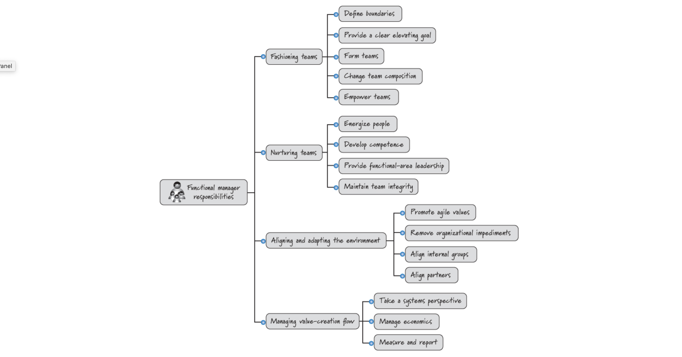
Managers

Slide 43
Managers – Fashioning Teams
Defining Boundaries
A self-organizing team manages its response to the environment in which it is placed. The environment, however, is under the influence of managers.
Provide a Clear Elevating Goal
Managers also provide a clear elevating goal to each team. This goal gives purpose and direction to the team.
Form Teams
Teams do not typically form themselves (team members do not self-select who will be on the team). Managers compose teams.

Slide 44
Managers – Fashioning Teams
Change Team Composition
Managers also have the obligation to change a team’s composition if they believe that doing so will improve the overall health and performance of the team and the organization as a whole.
Empower Teams
For teams to self-organize they must be empowered, which requires authorization and trust from managers. One principal way of empowering teams is for managers to delegate responsibilities to them with the primary goal of allowing self-organizing teams to manage themselves better.

Slide 45
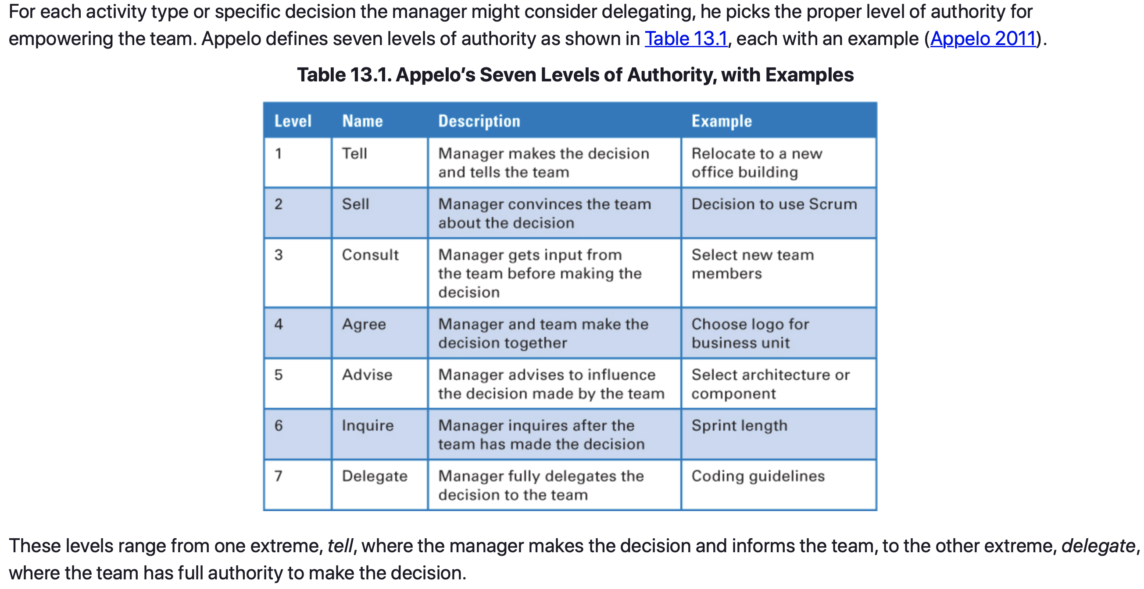
Managers – Fashioning Teams

Slide 46
Managers – Nurturing Teams
Energize People
Providing a clear elevating goal creates a foundation upon which to energize team members. By energize I mean that managers should constantly seek ways to motivate people to intrinsically want to do great work.
Develop Competence
Within Scrum organizations, each team member still reports to a functional or resource manager who is typically not the ScrumMaster or the product owner. And, just as in non-Scrum environments, these managers take an active role in coaching and assisting their direct reports with their career goals by promoting opportunities for competency development and providing frequent, actionable feedback on performance.

Slide 47
Managers – Nurturing Teams
Provide Functional Area Leadership
As in non-Scrum organizations, functional managers in Scrum organizations continue to provide leadership specific to their functional area. Functional managers usually have relevant working knowledge and can provide thought leadership within the area.
Maintain Team Integrity
Because the team replaces the individual as the unit of capacity, managers should work proactively to maintain team integrity. That means not pulling people off of teams mid-sprint to work on pet projects or unnecessarily assigning people to work on multiple teams.

Slide 48
Managers – Aligning and Adapting the Environment
Promote Agile Values
Managers must embrace agile values and principles. They need to understand and truly believe them, live them, and encourage others to do the same.
Remove Organiziational Impediments
Managers also work hand in hand with ScrumMasters to remove impediments. Though the ScrumMaster is the person pushing to remove organizational impediments, many impediments, especially those that are environmental (e.g. systemic) in nature, require intervention from managers to actually be removed.
Notes:
Getting a single team, or even the IT or development departments, to use Scrum is a good start. However, to realize the extraordinary benefits of Scrum, the entire value chain from suppliers to customers needs to embrace agile. Managers are responsible for aligning and adapting the environment (the value chain) by promoting agile values, removing organizational impediments, aligning internal groups, and aligning partners.

Slide 49
Managers – Aligning and Adapting the Environment
Align Internal Groups
The engineering or IT group is often the first to adopt Scrum. Let’s say that after a reasonable period of time the first-adopter group becomes very skilled at creating customer-valuable features each sprint. However, until those features are actually made available to customers, no real value has been delivered.
Align Partners
Managers must also help the organization embrace a more agile approach to supplier management and outsourcing. If the way we engage our external partners follows a traditional arms-length, contract-heavy, negotiation-style approach, the organization will fail to achieve its full potential with Scrum.

Slide 50
Managers – Managing Value Creation Flow
Take a Systems Perspective
To effectively manage the flow of value creation, managers must take a systems perspective. One of the larger impediments I have seen to successful Scrum adoption is when managers refuse to think systemically and instead focus only on their own areas or fiefdoms.
Manage Economics
Organizations expect managers to be trusted stewards of the financial resources that are made available to them. Higher-level managers in a Scrum organization therefore still manage economics (such as profit and loss) for their areas.
Notes:
Overall, managers in a Scrum environment are responsible for setting strategic direction and for ensuring that organizational resources are being marshaled in an economically sensible way to achieve strategic goals. Managers manage the value-creation flow by taking a systems perspective, managing economics, and measuring and reporting.

Slide 51
Managers – Managing Value Creation Flow
Monitor Measures and Reports
Many measures and reports are collected and generated at the request of managers, so there is a real opportunity for managers to ensure that only those measures that add to the value-creation flow are captured and reported. This goal can be achieved by ensuring that measures and reporting align well with core Scrum values and principles.
Focus on idle work, not idle workers. A measure such as cycle time will expose the length of time between when work starts and when it finishes. If cycle time is increasing, you need to investigate why.
Measure progress by working, validated assets. Focus on measuring the value delivered (working and validated assets), but don’t lose sight of the variables (date, scope, budget, and quality) needed to deliver value.
Organize flow for fast feedback. Align your measures to determine how quickly the learning cycle is completed (assume, build, feedback, inspect, and adapt).

Slide 52
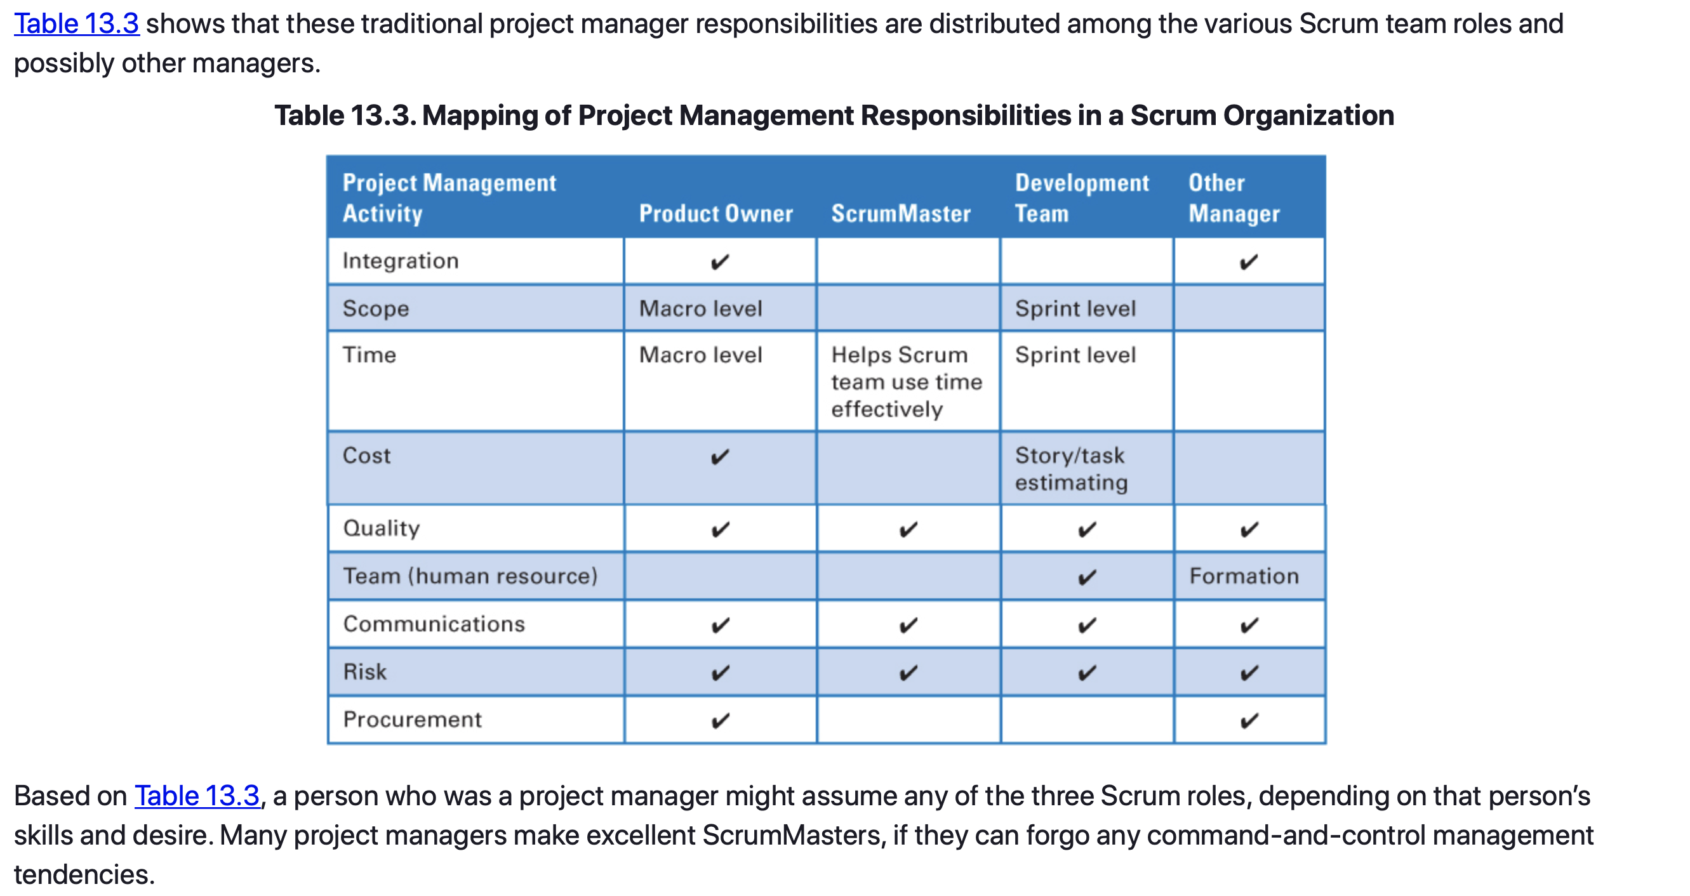
Managers – Project Managers
Notes:
A common misperception is that the ScrumMaster is really just the “agile project manager” or a project manager with a different title. On the surface there are some similarities between a ScrumMaster and a project manager—for example, both do impediment removal. However, being a servant leader significantly differentiates this role from a more command-and-control-focused project manager.

Slide 53
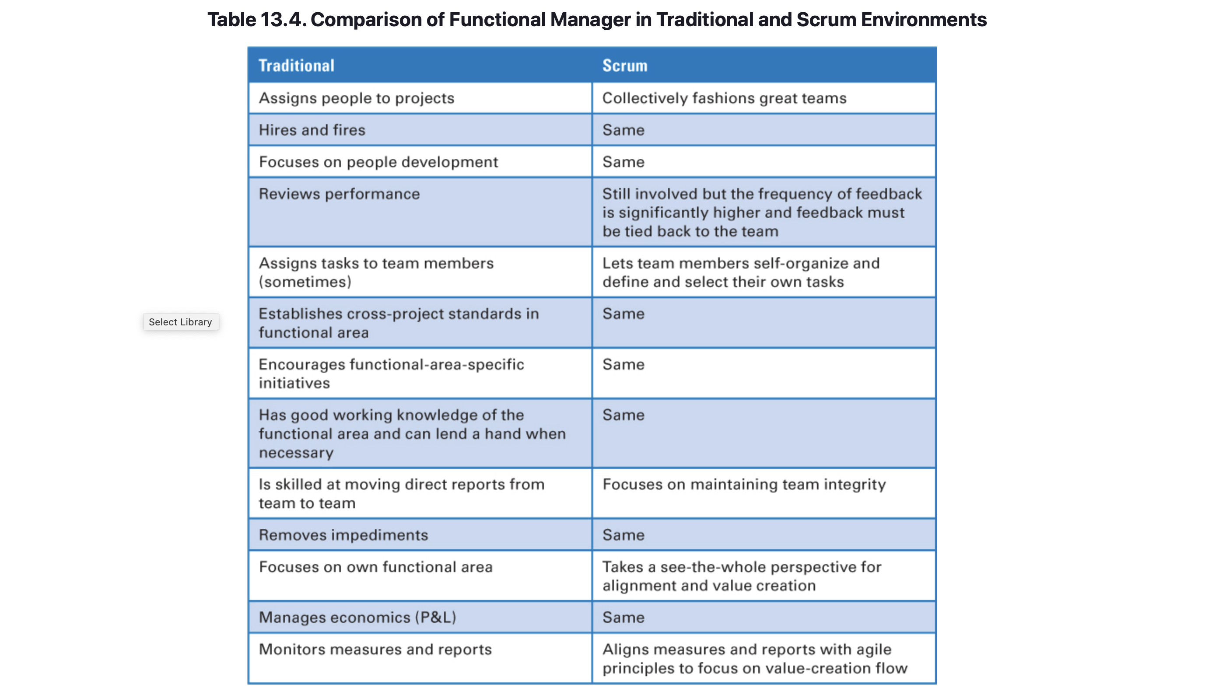
Managers – Closing

Slide 54
Sources
Unless otherwise noted, all material in these slides were used from the textbook for this course:
Rubin, Kenneth S., Essential Scrum: A Practical Guide to the Most
Popular Agile Process, 1st Edition. Addison-Wesley Professional; 1st
edition (August 5, 2012). ISBN-13: 978-0137043293.

